Slide 1


Updates
Olivier Bergeron

Slide 2

Electrode Impedance Test
Electrode under test
Saline solution 0.9%
Counter electrode

Slide 3
Electrode Impedance Test
Why this setup
2 electrodes get closed electrochemical circuit
Electrode impedance is defined by ionic transfer at electrode-electrolyte interface -> reason for ionic solution
Why saline? Physiologically relevant
Keep environment the same from one electrode under test from another.
Same distance between electrode under test and counter electrode
Use same ionic solution

Slide 4
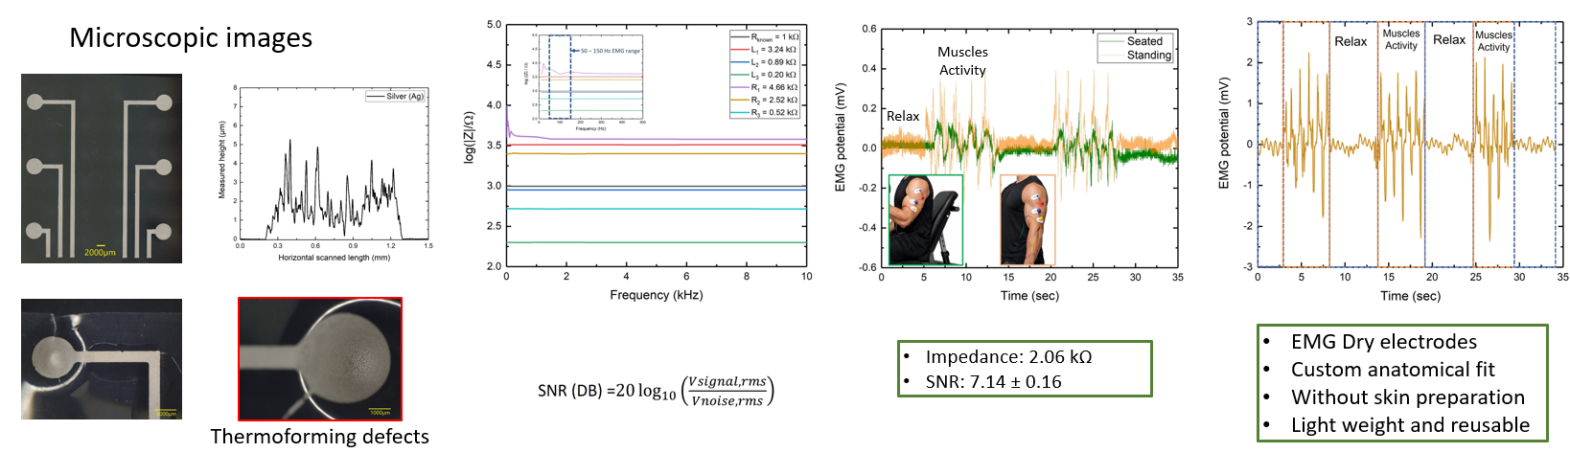
Ricardo’s and Ankur electrodes

Slide 5
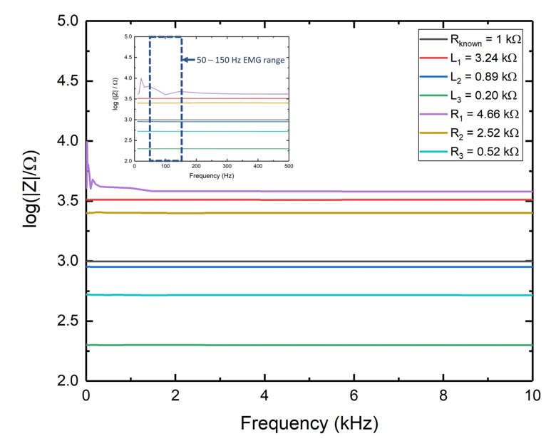
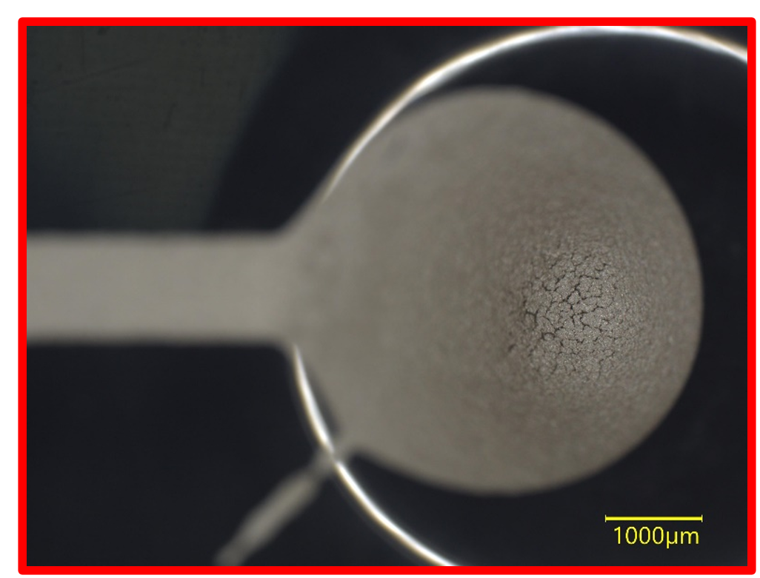
Electrode Impedance Test
Issues with the patch
Traces same material as the electrode: big impedance difference between one electrode to another
40 mm longer traces between L1 – L2
Cracks in the ink
Connection issues

Slide 6
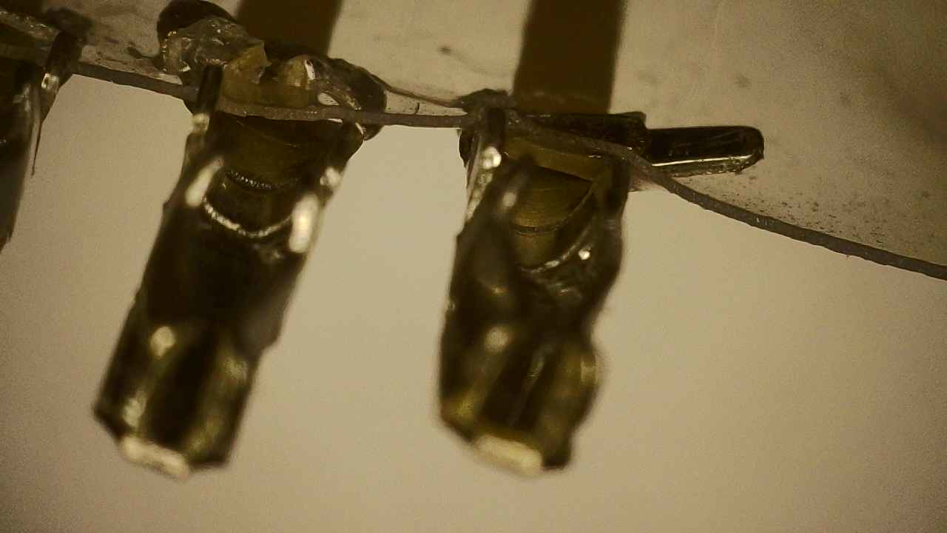
Connection issues

Slide 7
Intan read setup
Goal: Quick setup for reading EMG signals
What: RP2040
Dual core MCU
Core 1: SPI acquisition
Core 2: USB streaming to PC

Slide 8
Intan read setup
What has been done
USB streaming works with dummy data
What to do next
SPI data collection
Saving data into PC

Slide 9
Next steps
Prepare the impedance test setup
Continue EMG reading setup
Prepare post-processing algorithms (BSS, 2CFastICA, etc.)

